Slide 1

Healthy Weight on FHIR CDC Analytics Reporting Application
Team-Too Deiverable 2: Progress Report

Slide 2

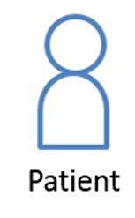

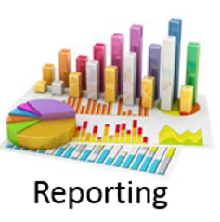
Project Goal: Develop application to better understand and prevent childhood obesity
Care Manager
Used by care manager to manage physician referrals
Patient
Provider
Used by patients to track behaviors relevant to obesity
Used by physicians to track and interpret patient data
Analytics & Reporting
Aggregates collected data and analyzes at a population level
In Development by
Team Too

Slide 3
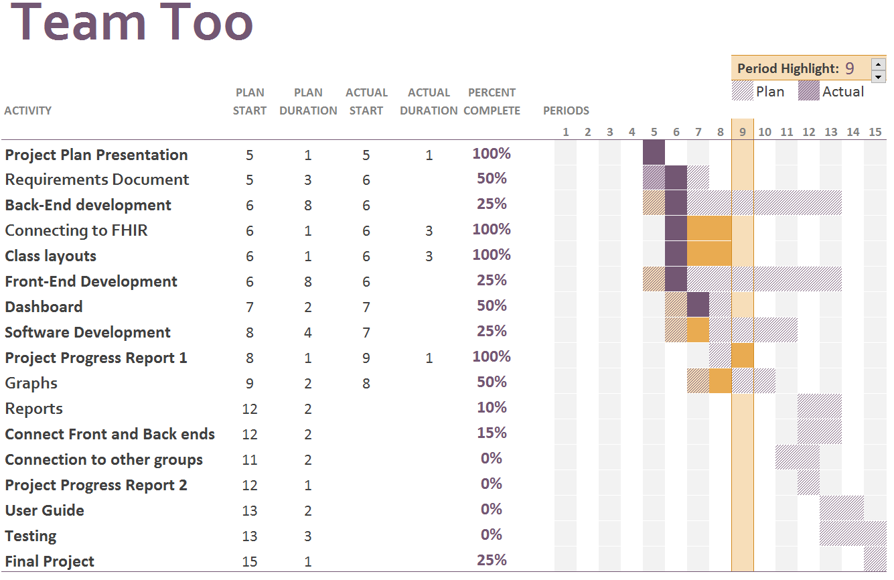
Development -- Gantt Chart

Slide 4
Development Update:
Significant Milestones
FHIR Server Connection Established
Initial Class Layouts Complete
Analytics for BMI
In-Progress Components
Front-end / Back-end Integration
Dashboad
Data Visualizations and Graphics
Reporting
Important Next Steps
Connection to Other Applications
Lockdown Requirements from Other Groups

Slide 5
Development Challenges:
FHIR Server connection difficulty
Georgia Tech FHIR Server
Current version feature-limited
Decided against entity framework Lack of direct server connectivity

Slide 6
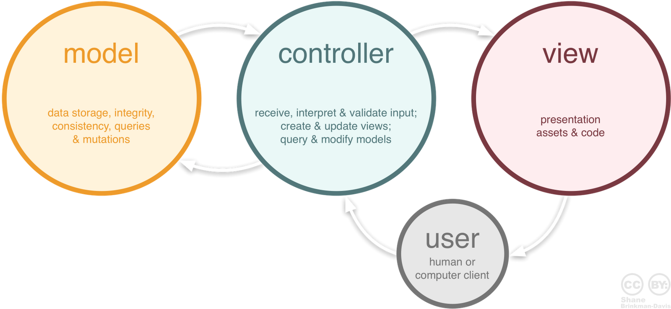
Model-view Controller (MCV) Architecture
Notes:
Common design for user interface implementation
(GUIs / Web Applications)
Three interconnected components
Separate internal representation of information
From manner information presented or received user

Slide 7


Architectural Design:
Object-oriented view
Patient class with respective attributes
Patient series data
Height with weight measurements
Observations
Lab results
View passed as a JSON package
Open and display graphics for user selections
Generate a report for the user
Controller information parsed into respective classes
Handles transfer of JSON package to the View
Notes:
MVC is the architectural pattern that our team has chosen to tackle the Analytics & Reporting web page.
Model is designed with a object-oriented view, the main class is patient with their respective attriburtes.
The patient can have a series of different height measurements along with weight measurements.
The patient can have observations or labs results also.
The View is being passed a JSON package to open and display graphs based on the user selections.
The View may also be passed a JSON to generate a report for the user
The Controller is where the information is parsed into respective classes and handles transfering the JSON package to the View.

Slide 8
Useability
Web implementation assessible to other apps
Secured single log-in
Data sharing & analytics integration
GUI for generating analysis & reports
Data selection & grouping
Intuitive database queries
Visualization tools
User-configurable graphing features
Retrieve records in manageable format
Exporting functions
Common format output for export to other systems (.xml, .csv)
Creation of .pdf reports
Analytics & Reporting
Application

Slide 9
Programming Languages:
C#
Fast paced web development
Originally selected for use w/ Entity Framework
Simple FHIR server connectivity
Team has familiarity with the language
.Net framework features
JSON
Sending information to the front-end
Organized data-type
Analytics & Reporting
Application

Slide 10
Tools:
Highcharts
Javascript charts for GUI
Non-commercial licenses available
AngularJS
Framework for client-side model-view
controller architecture
Frontend
Fast Healthcare Interoperability Resources (FHIR) server
Primary content resource for the application
Backend
HL7.FHIR library
Plugin to simply database access

Slide 11
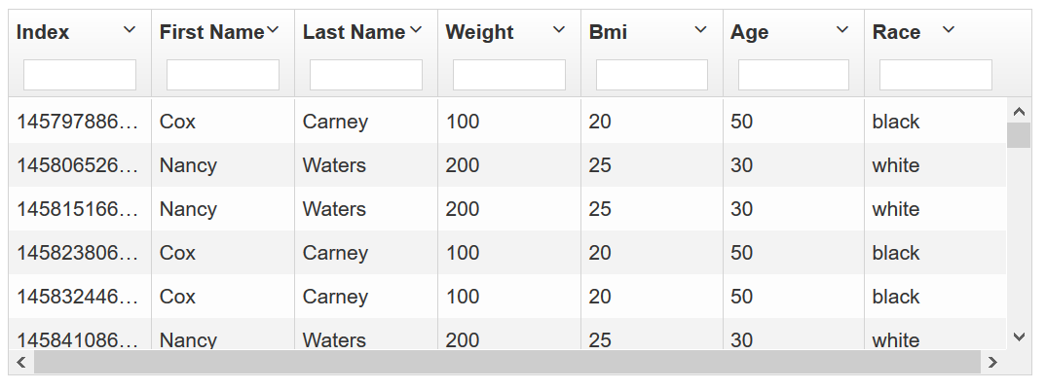
Preliminary Data Analytics & Reporting
FHIR Server Data
Interface Features
Field searchable
Data selection / sorting / filtering
Automatic BMI Calculator
Flags / Notices

Slide 12
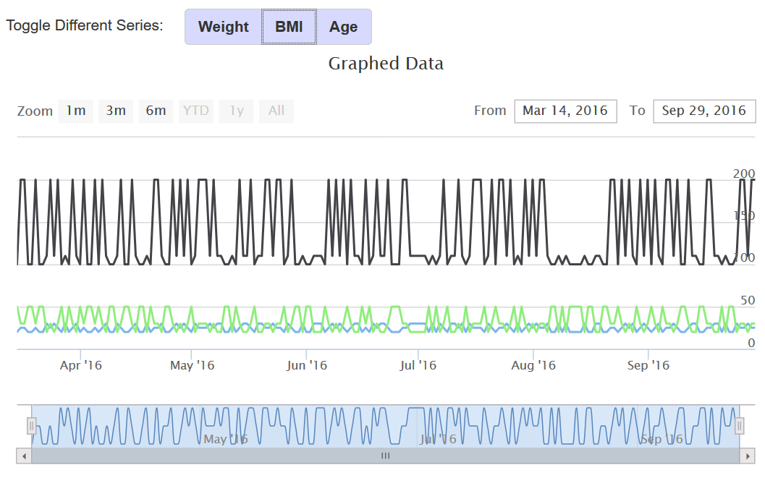
Preliminary Data Analytics & Reporting
Interface Features
Selectable attributes
Ranges / sorts / filters
Automatic graphic overlays & formatting
More features to come!

Slide 13
Thank You!
Project Manager
Developer
Daniel Hegberg
Data analysis & reporting
Frontend Developer
Backend Developer
David Bailey
Team-Too
David Stevens
User Interface Design
Report generation
Quality Assurance
Team Liaison
Kirk Pastorian
Research & Testing

